Slide 1
A core Course on Modeling
Introduction to Modeling
0LAB0 0LBB0 0LCB0 0LDB0
c.w.a.m.v.overveld@tue.nl
v.a.j.borghuis@tue.nl
P.11

Slide 2
Applying SPEA: the bicycle trip
The bicycle trip 1: minimize W, maximize s, vary v and t.
The bicycle trip 2: minimize W, minimize t, vary s and v.
Model 1: trade-off between W and s
Model 2: no trade-off between W and t
Implement trade-off in Model 1 in two ways:
Lumping
Pareto-genetic

Slide 3
Applying SPEA: the bicycle trip
The bicycle trip 1: minimize W, maximize s, vary v and t.
Lumping:
q= w_{w}*W+w_{s}*s⁻¹
Arbitrary values for w_{w} and w_{s}:
w_{w}=1 m⁻¹, w_{s}=1 kg m²/s²
w_{w}=1000m⁻¹, w_{s}=1 kg m²/s²
w_{w}=1 m⁻¹, w_{s}=1000kg m²/s²
low effort is more important
long distance is more important

Slide 4
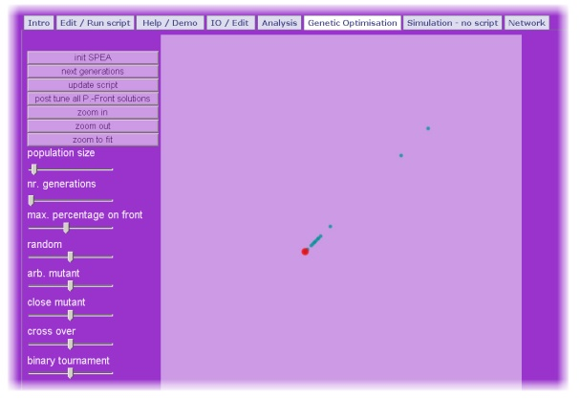
Applying SPEA: the bicycle trip
The bicycle trip 1: minimize W, maximize s, vary v and t.
Lumping:
W=fW*s; kg.m2/s2
fW=c*rho*A*vMPS*vMPS; kg.m/s2
vKMPH=slider(15.0,0.0,40.0); km/h
vMPS=vKMPH*mPKM/secPH; m/s
s=vMPS*tSec; m
tH=slider(1.0,0.0,5.0); h
tSec=tH*secPH; s
rho=1; kg/m3
A=0.6; m2
c=0.5
secPH=3600; s/h
mPKM=1000; m/km
wW=1;1/m
wS=1;kg.m2/s2
q=wW*W+wS/s
qMin1=paretoMin(paretoHor(q))
qMin2=paretoMin(paretoVer(q))
qMin2 = qMin1
qMin1

Slide 5
Applying SPEA: the bicycle trip
The bicycle trip 1: minimize W, maximize s, vary v and t.
Lumping:
W=fW*s; kg.m2/s2
fW=c*rho*A*vMPS*vMPS; kg.m/s2
vKMPH=slider(15.0,0.0,40.0); km/h
vMPS=vKMPH*mPKM/secPH; m/s
s=vMPS*tSec; m
tH=slider(1.0,0.0,5.0); h
tSec=tH*secPH; s
rho=1; kg/m3
A=0.6; m2
c=0.5
secPH=3600; s/h
mPKM=1000; m/km
wW=1;1/m
wS=1;kg.m2/s2
q=wW*W+wS/s
qMin1=paretoMin(paretoHor(q))
qMin2=paretoMin(paretoVer(q))
qMin2 = qMin1
qMin1

Slide 6
Applying SPEA: the bicycle trip
The bicycle trip 1: minimize W, maximize s, vary v and t.
Lumping:
In case of lumping we combine the criteria low W and large s with arbitrarily chosen weight factors w_{w} and w_{s}.
There is 1 non-dominated point with some v and t.
With another choice for w_{w} and w_{s} , another v and t would have resulted.
qMin2 = qMin1
qMin1

Slide 7
Applying SPEA: the bicycle trip
The bicycle trip 1: minimize W, maximize s, vary v and t.
Lumping:

Slide 8
Applying SPEA: the bicycle trip
The bicycle trip 1: minimize W, maximize s, vary v and t.
b. Pareto-genetic:
Deal with both criteria (minimize W and maximize s) separately

Slide 9
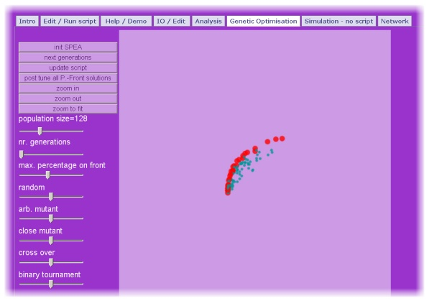
Applying SPEA: the bicycle trip
The bicycle trip 1: minimize W, maximize s, vary v and t.
b. Pareto-genetic:
W=fW*s; kg.m2/s2
fW=c*rho*A*vMPS*vMPS; kg.m/s2
vKMPH=slider(15.0,1.0,40.0); km/h
vMPS=vKMPH*mPKM/secPH; m/s
s=vMPS*tSec; m
tH=slider(1.0,0.0,5.0); h
tSec=tH*secPH; s
rho=1; kg/m3
A=0.6; m2
c=0.5
secPH=3600; s/h
mPKM=1000; m/km
WMin=paretoMin(paretoHor(W))
sMax=paretoMax(paretoVer(s))
sMax
WMin

Slide 10
Applying SPEA: the bicycle trip
The bicycle trip 1: minimize W, maximize s, vary v and t.
b. Pareto-genetic:
W=fW*s; kg.m2/s2
fW=c*rho*A*vMPS*vMPS; kg.m/s2
vKMPH=slider(15.0,1.0,40.0); km/h
vMPS=vKMPH*mPKM/secPH; m/s
s=vMPS*tSec; m
tH=slider(1.0,0.0,5.0); h
tSec=tH*secPH; s
rho=1; kg/m3
A=0.6; m2
c=0.5
secPH=3600; s/h
mPKM=1000; m/km
WMin=paretoMin(paretoHor(W))
sMax=paretoMax(paretoVer(s))
sMax
WMin

Slide 11
Applying SPEA: the bicycle trip
The bicycle trip 1: minimize W, maximize s, vary v and t.
b. Pareto-genetic:
In case of NO lumping we keep the criteria low W and large s separate; no weight factors required.
There are multiple non-dominated points (the red dots), each with their v and t.
Each of these points could be a reasonable choice – in the sense that no better (=dominating) choices exist.
sMax
WMin

Slide 12
Applying SPEA: the bicycle trip
The bicycle trip 1: minimize W, maximize s, vary v and t.
b. Pareto-genetic:

Slide 13
Applying SPEA: the bicycle trip
The bicycle trip 2: minimize W, minimize t, vary v and s.
b. Pareto-genetic:
There is no actual trade-off.
We therefore don’t expect multiple non-dominated solutions.

Slide 14
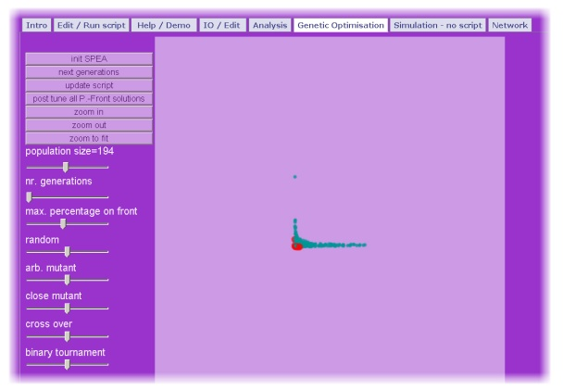
Applying SPEA: the bicycle trip
The bicycle trip 2: minimize W, minimize t, vary v and s.
b. Pareto-Genetic:
W=fW*sM; kg.m2/s2
fW=c*rho*A*vMPS*vMPS; kg.m/s2
vKMPH=slider(15.0,0.0,40.0); km/h
vMPS=vKMPH*mPKM/secPH; m/s
sKM=slider(5.0,0.0,120.0); km
sM=sKM*mPKM; m
tSec=sM/vMPS; s
tH=tSec/secPH; h
rho=1; kg/m3
A=0.6; m2
c=0.5
secPH=3600; s/h
mPKM=1000; m/km
WMin=paretoMin(paretoHor(W)); kg.m2/s2
tMin=paretoMin(paretoVer(tH)); h
tMin
WMin

Slide 15
Applying SPEA: the bicycle trip
The bicycle trip 2: minimize W, minimize t, vary v and s.
b. Pareto-Genetic:
W=fW*sM; kg.m2/s2
fW=c*rho*A*vMPS*vMPS; kg.m/s2
vKMPH=slider(15.0,0.0,40.0); km/h
vMPS=vKMPH*mPKM/secPH; m/s
sKM=slider(5.0,0.0,120.0); km
sM=sKM*mPKM; m
tSec=sM/vMPS; s
tH=tSec/secPH; h
rho=1; kg/m3
A=0.6; m2
c=0.5
secPH=3600; s/h
mPKM=1000; m/km
WMin=paretoMin(paretoHor(W)); kg.m2/s2
tMin=paretoMin(paretoVer(tH)); h
tMin
WMin

Slide 16
Applying SPEA: the bicycle trip
The bicycle trip 2: minimize W, minimize t, vary v and s.
b. Pareto-Genetic:
In case there is no trade off, the Pareto front collapses into a single non-dominated point: v=0 and s=0
tMin
WMin

Slide 17
Applying SPEA: the bicycle trip
The bicycle trip 2: minimize W, minimize t, vary v and s.
b. Pareto-Genetic:

Slide 18
Applying SPEA: the bicycle trip
The bicycle trip 2: minimize W, minimize t, vary v and s;
The bicycle trip 1: minimize W, maximize s, vary v and t:
one modeled system
two (or more) models
some with trade-offs, others without trade-offs
choose whether you use lumping or Pareto-genetic
Always ask: which strategy is adequate for current purpose?

